Slide 1
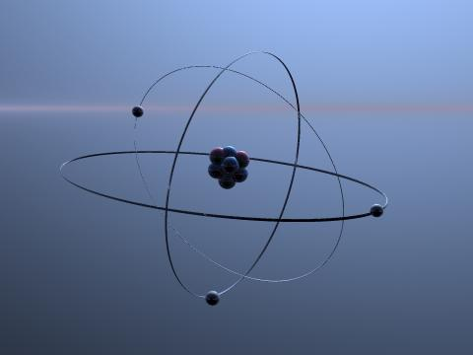
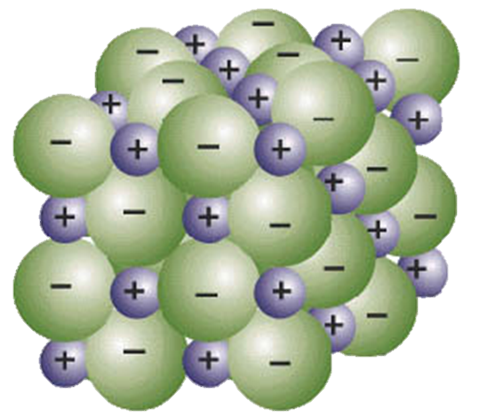
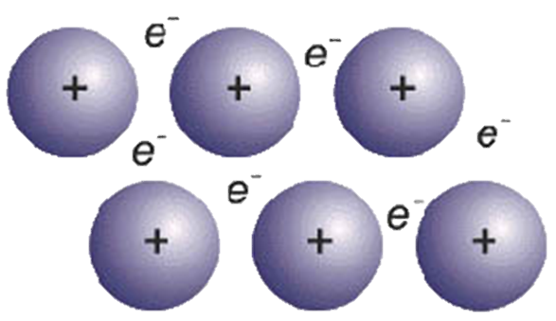
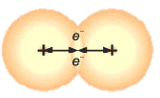
Types of Bonding
IONIC METALLIC COVALENT
Metal + Non metal Metal only Non-metal only

Slide 2
Ionic Bonding

Slide 3
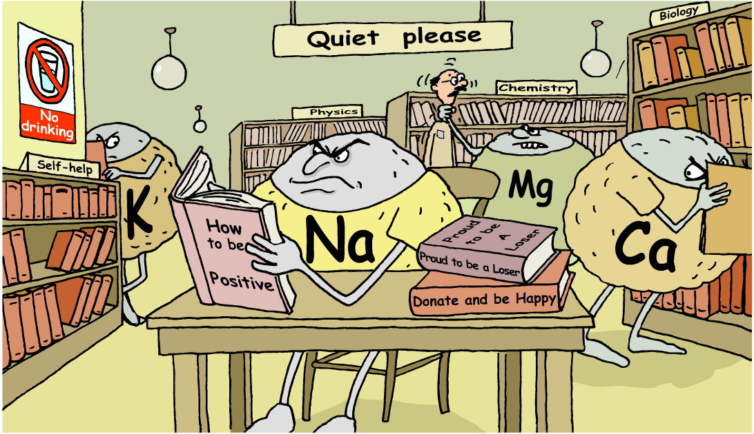
From atoms to ions
How can reactive metal atoms become stable positive ions?
Notes:
Teacher notes
This illustration contains representations of how metal atoms are unstable until they lose electrons when they become stable positive ions.
It can be used as an introduction to the topic.
There are several discussion points relating to the topic:
Angry looking metal atoms Until atoms donate electrons to non-metals atoms, they are unstable and reactive.
Self help books On the topic of donating and becoming positive – metal atoms that donate electrons will become positive and more stable and therefore ‘happier’.
No drinking sign because the metal atoms are very reactive and would react readily with water.

Slide 4
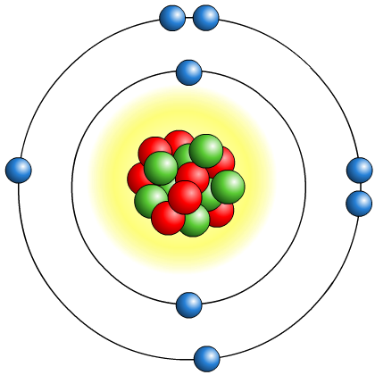
How do atoms form ions?
An ion is an atom or group of atoms that has an electrical charge, either positive and negative.
Atoms have an equal number of protons and electrons and so do not have an overall charge.
Atoms with incomplete outer electron shells are unstable. By either gaining or losing electrons, atoms can obtain an electron arrangement like the noble gasses and become stable.
When this happens, atoms have an unequal number of protons and electrons and so have an overall charge. This is how atoms become ions.
How does an atom become a positive or negative ion?

Slide 5
Positive and negative ions?
An atom that loses electrons has more protons
than electrons and so has a positive overall charge. This is called a positive ion.
An atom that gains electrons has more electrons than protons and so has a negative overall charge. This is called a negative ion.
The electron configuration of an atom shows how many electrons it must lose or gain to have a filled outer shell.
Atoms with a nearly empty outer shell, will lose electrons to obtain a full outer shell.
Atoms with a nearly full outer shell, will gain electrons to obtain a full outer shell.

Slide 6
How do atoms form positive ions?
An atom that loses one or more electrons forms a positive ion.
Metal atoms, such as sodium, magnesium and iron, form positive ions.
Positive ions have a small ‘+’ symbol and a number by this to indicate how many electrons have been lost.
This number is usually the same as the number of electrons in the atom’s outer shell. For example:
lithium atom 2.1
lithium ion [ 2 ]
= Li⁺
magnesium atom 2.8.2
magnesium ion [ 2.8 ] = Mg²⁺
aluminium atom 2.8.3
aluminium ion [ 2.8 ]
= Al³⁺
Notes:
Teacher notes
It should be pointed out that the lithium ion is represented by Li⁺ not Li¹⁺.

Slide 7

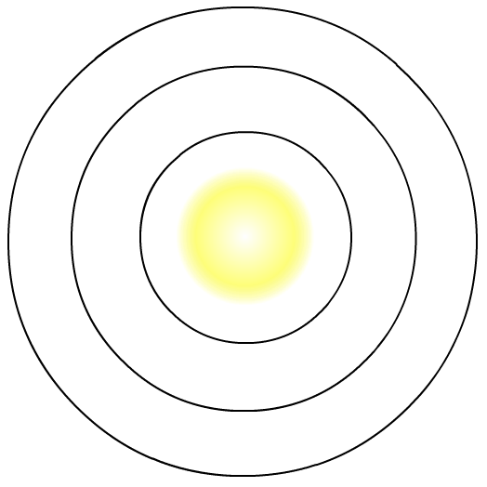
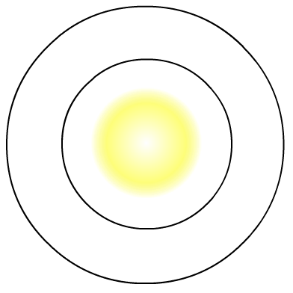
How is a sodium ion formed?
Sodium atom:
Sodium ion:
11 protons = +11
11 protons = +11
11 electrons = -11
10 electrons = -10
Total charge = 0
Total charge = +1
+
loses
1 electron
Na
Na
2.8.1
(partially full outer shell)
[2.8]
(full outer shell)

Slide 8
How is a magnesium ion formed?
Magnesium atom:
Magnesium ion:
12 protons = +12
12 protons = +12
12 electrons = -12
10 electrons = -10
Total charge = 0
Total charge = +2
2+
loses
2 electrons
Mg
Mg
2.8.2
(partially full outer shell)
[2.8]²⁺
(full outer shell)

Slide 9
How do atoms form negative ions?
An atom that gains one or more electrons forms a negative ion.
Non-metal atoms, such as chlorine, oxygen and nitrogen, form negative ions.
Negative ions have a small ‘-’ symbol and a number by this to indicate how many electrons have been gained to fill their outer shell. For example:
chlorine atom
2.8.7
chloride ion [ 2.8.8 ]= Cl⁻
oxygen atom
2.6
oxide ion [ 2.8 ]
= O²⁻
nitrogen atom
2.5
nitride ion [ 2.8 ]
= N³⁻
The name of the ion is slightly different to the atom’s name.
Notes:
Teacher notes
It should be pointed out that the chloride ion is represented by Cl⁻ not Cl¹⁻

Slide 10

How is a fluoride ion formed?
Fluorine atom:
Fluoride ion:
9 protons = +9
9 protons = +9
9 electrons = -9
10 electrons = -10
Total charge = 0
Total charge = -1
-
gains 1 electron
F
F
2.7 (partially full outer shell)
[2.8]⁻
(full outer shell)

Slide 11
How is a sulfide ion formed?
Sulfur atom:
Sulfide ion:
16 protons = +16
16 protons = +16
16 electrons = -16
18 electrons = -18
Total charge = 0
Total charge = -2
2-
gains 2 electrons
S
S
2.8.6 (partially full outer shell)
[2.8.8]²⁻
(full outer shell)

Slide 12
Sodium Fluoride
This is how we notate Ionic Bonds or Lewis diagrams. You may also leave the inner shells off.
+
-
Na
F
[2.8]
[2.8]⁻
(full outer shell)
(full outer shell)

Slide 13
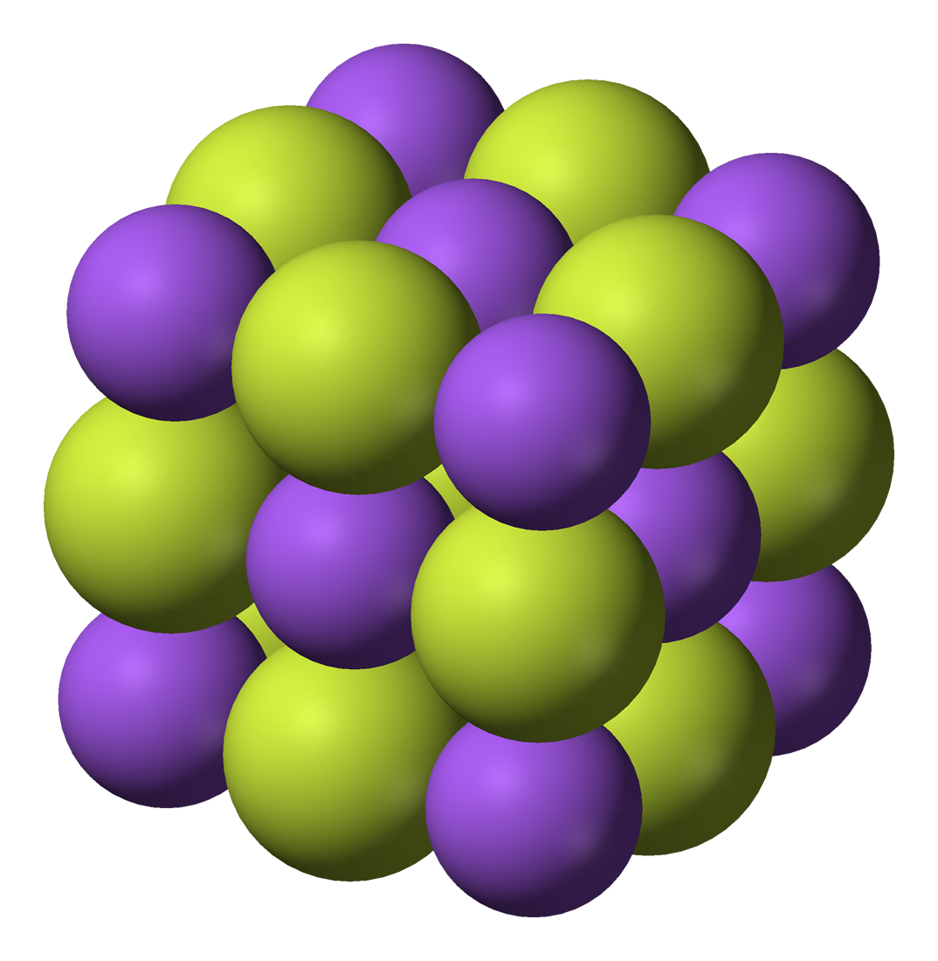
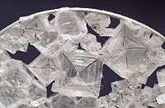
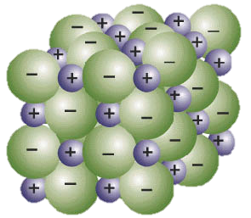
Sodium Fluoride Lattice

Slide 14
Properties
Ions are locked in the lattice therefore;
They don’t conduct electricity
They have a High M.P
When you dissolve them and melt them [at ~800 degrees] they can conduct because the ions are free to move.

Slide 15
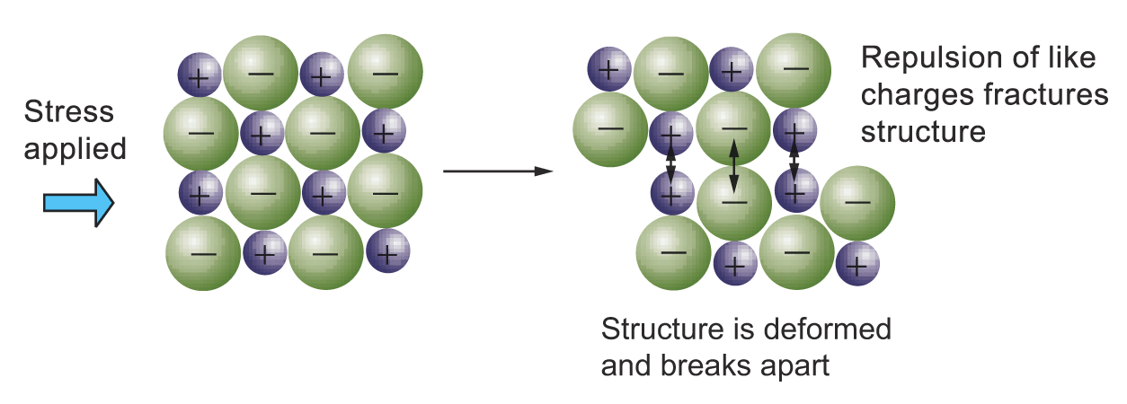
Typical properties of ionic bonds - Brittle

